Slide 1
Smart Transportation System Using with GPS Wireless Camera
Guided By :
MRS.LALITHA K
PRESENTED By :
MADHAN.V [22AI025]
SABARISREE.M.Y [22AI043]
HEMANITHRAN.R.S [22AI060]
TEAM NO : 23
22AIP10 & INTERNET OF THINGS LABORATORY

Slide 2
Abstract:
This project develops an IoT-based smart transportation system using an ESP32 CAM for wireless video monitoring, GPS for location tracking, and remote control of a solenoid lock, enhancing vehicle security and management.

Slide 3
Objectives:
The objective of this project is to create a smart transportation system that provides real-time vehicle tracking, remote video monitoring, wireless access control, and reliable power management using IoT technology.

Slide 4
Components Required:
ESP32 CAM:
Relay Module:
Solenoid Lock
12V Power Supply/Battery
7805 Voltage Regulator
ByLink App

Slide 5
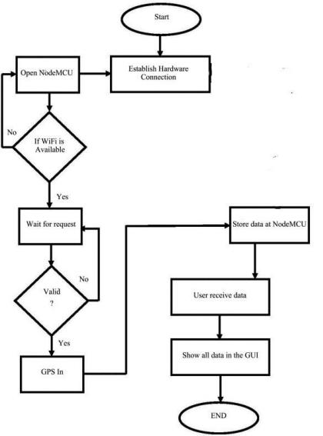
Flow Diagram:

Slide 6
Design:
Hardware Design:
The ESP32 CAM acts as the main controller, managing the relay module that powers the solenoid lock.
The solenoid lock is controlled by the relay module based on signals from the ESP32 CAM.
An LED connected to the ESP32 CAM shows the system status.
A 12V power supply is converted to 5V using a 7805 regulator to power the ESP32 CAM.
A capacitor filters out power noise to ensure stable operation.

Slide 7
Implementation:
Hardware:
ESP32 CAM Setup: Connect the ESP32 CAM to Wi-Fi and write firmware to control the camera and relay.
Relay and Solenoid Lock: Connect the relay module to the ESP32 CAM and the solenoid lock to the relay.
Power Management: Use a 12V power supply, regulated to 5V with a 7805 regulator, and stabilize with a 100uF capacitor.
LED Connection: Attach an LED to a GPIO pin on the ESP32 CAM for status display.
System Integration: Combine all components with correct connections and settings.
Testing: Verify that the camera, GPS tracking, relay, solenoid lock, and LED work properly.

Slide 8
Conclusion:
This IoT-based smart transportation system improves vehicle security and management with real-time monitoring and control, offering a reliable and scalable solution for safer transportation operations.

Slide 9


